Slide 1

Clustered Regression of Python Questions from Stack Overflow
Mike Jovanovich
Shoira Shamsieva

Slide 2
What is Stack Overflow?
“Stack Overflow is a question and answer site for professional and enthusiast programmers. It's built and run by you as part of the Stack Exchange network of Q&A sites. With your help, we're working together to build a library of detailed answers to every question about programming” @stackoverflow.

Slide 3
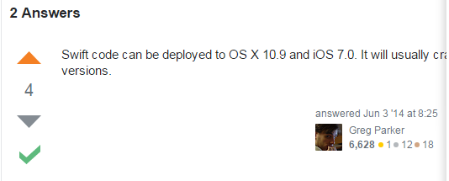
How does it work?
This site is all about getting answers. It's not a discussion forum.
Good answers are voted up and rise to the top.
The best answers show up first so that they are always easy to find.
The person who asked can mark one answer as "accepted".
Accepting doesn't mean it's the best answer, it just means that it worked for the person who asked.

Slide 4
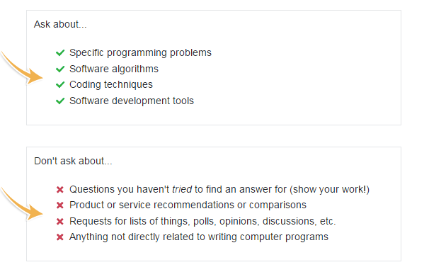
Get answers to practical, detailed questions

Slide 5
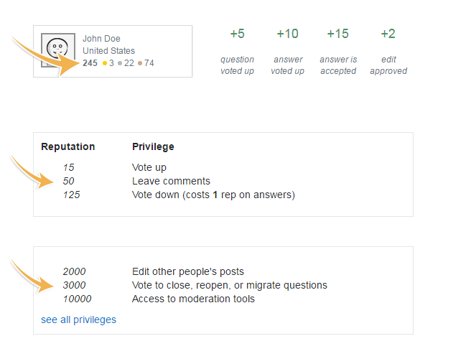
You earn reputation when people vote on your posts

Slide 6
Goal: To predict answer rank as accurately as possible
Dataset Source: Kaggle
https://www.kaggle.com/stackoverflow/pythonquestions
Full text of questions and answers from Stack Overflow that are tagged with the python tag
Around 1 million instances, 10,000 rows randomly selected for our research
Tools/Languages Used: Python
(libraries - Panda, nltk, scikit), R and Weka

Slide 7
Variables in the dataset
AnswerScore - this variable that we are trying to predict
AnswerBodyWordCount - word count after stripping HTML and articles
AvgCurrentScore - average question score for question user
AvgQuestionUserScore - average question score for question user
NumCodeSnippets - number of <code> tags in answer
NumCurrentAnswers - number of answers to the question at the time the current answer was posted
NumLinks - number of <a> tags in answer
NumQuestionsAnswered – number of questions answered by the user
QuestionBodyWordCount - word count after stripping HTML and articles
QuestionScore - score of question
TimeElapsed - time elapsed since question was posted

Slide 8
Feature Selection
Principal Components
Ranks Selected
QuestionScore
AvgQuestionUserScore
AvgCurrentScore
NumCurrentAnswers
NumCodeSnippets
CfsSubsetEval used full training set
Ranks Selected
NumCodeSnippets
QuestionScore
ReliefAttributeEval
Ranks Selected
QuestionScore
AvgCurrentScore
NumLinks
NumCurrentAnswers
AnswerBodyWordCount
NumCodeSnippets
The rest of Attribute Evaluators were greyed out
WrapperSubset Eval - came back empty
Final Features Selected: QuestionScore, AvgCurrentScore, NumCurrentAnswers, NumCodeSnippets, AnswerBodyWordCount

Slide 9
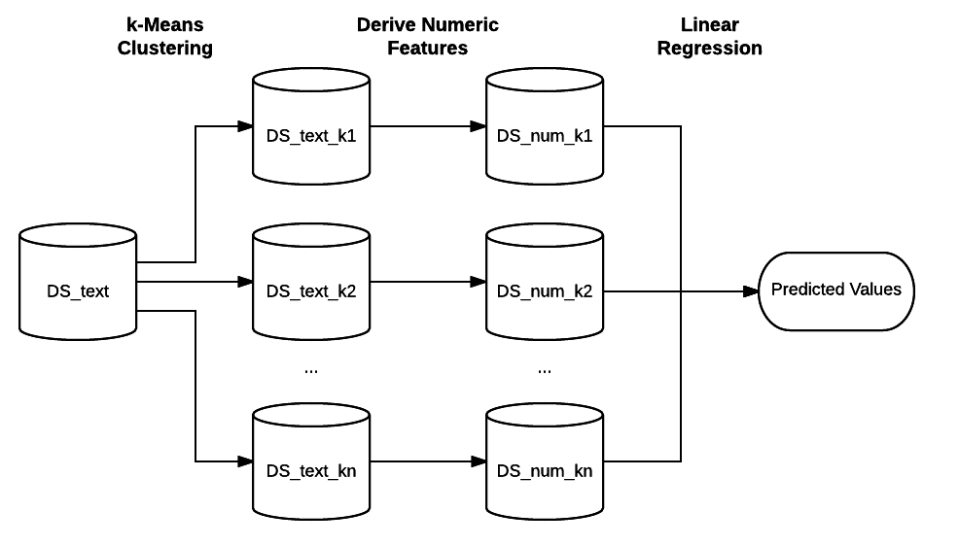
Prediction Methods Used

Slide 10
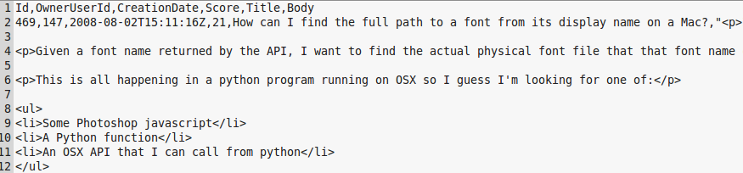
Dataset Example
Input Dataset
“Bag of words” approach used with stemming to construct text dataset.
Question stems prefixed with “q_”, response stems prefixed with “r_”.
Numeric Dataset
Text Dataset

Slide 11
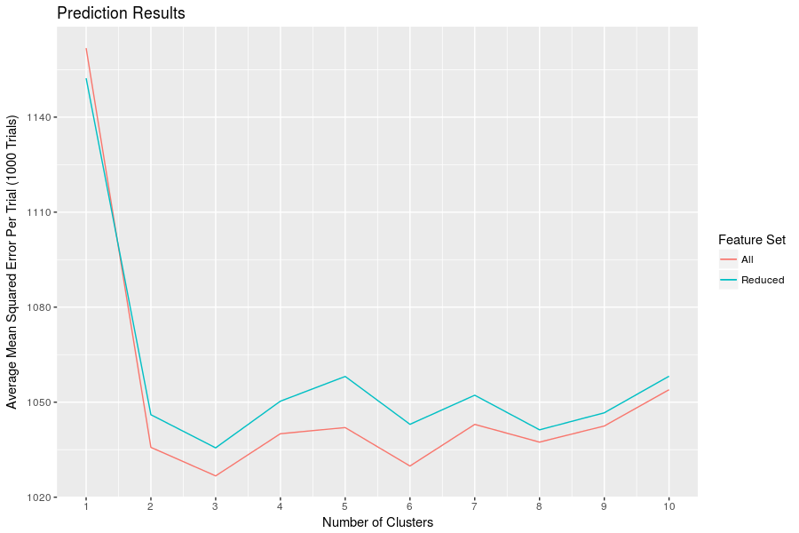
Results

Slide 12
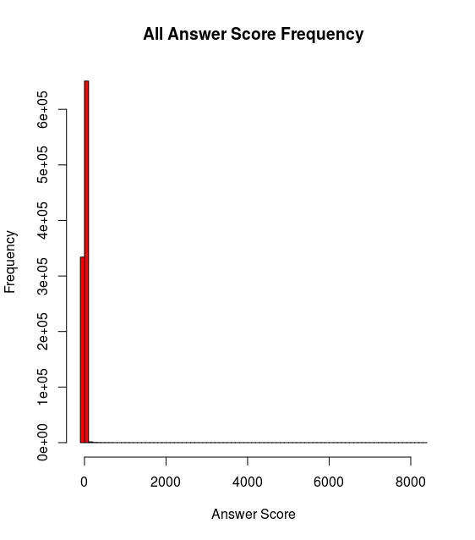
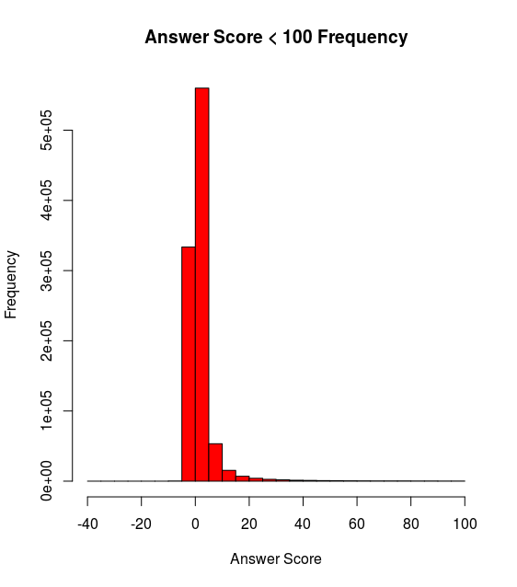
Analysis - Answer Score Distribution
Highly skewed with very long tail
Many Outliers

Slide 13
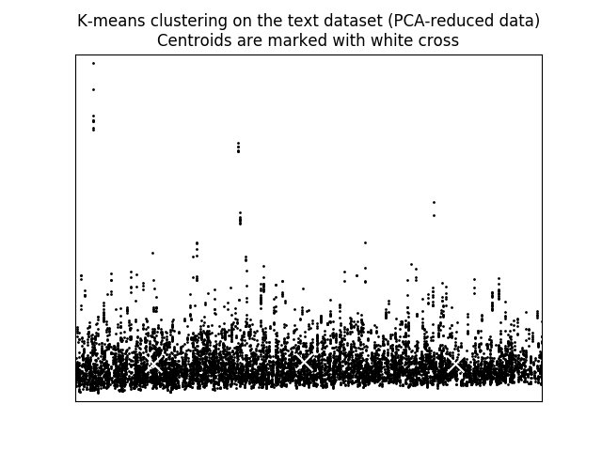
Analysis -
Text Feature Distribution
When we reduce 10000 x 2000 text stem feature set to 2 dimensions we see a poor y dimension spread - bad for clustering.
Questions and answers were probably too short for this technique to be effective

Slide 14
Conclusion
Difficulties:
Data encoding - latin to utf-8
Empty features
Data in separate files needed to be combined in relational manner (not already in database)
Text dataset was so large it did not fit in memory - had to pull in pieces from disk
To Improve:
Remove outliers
Test this methodology on a set where the features that will be used for clustering are better distributed
Overall:
This algorithm has the potential to be useful on certain types of data, but needs further testing

